Slide 1
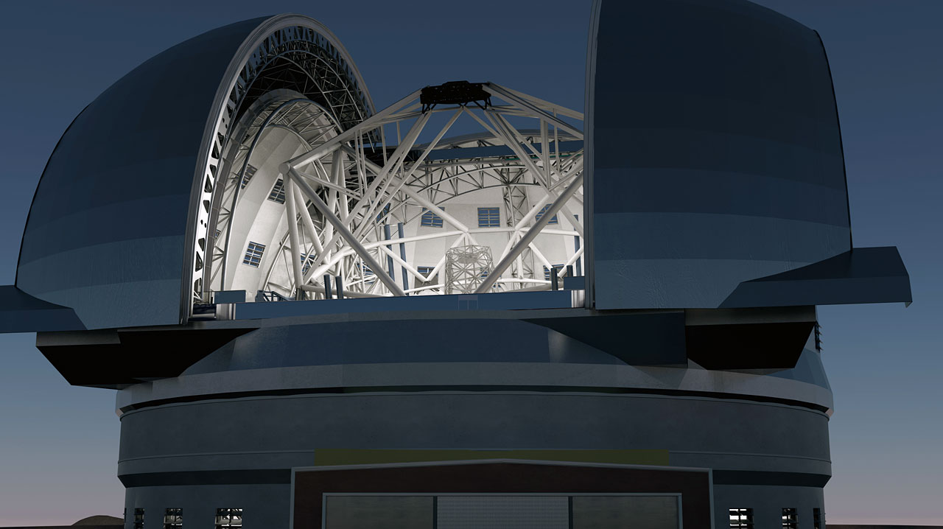


European Extremely
Large Telescope
Aprajita Verma
University of Oxford
With thanks to UK E-ELT Project Team & E-ELT Team at ESO
Notes:
Title with new rendered figure (Oct 2011)
Your institute logo can go on right if desired

Slide 2
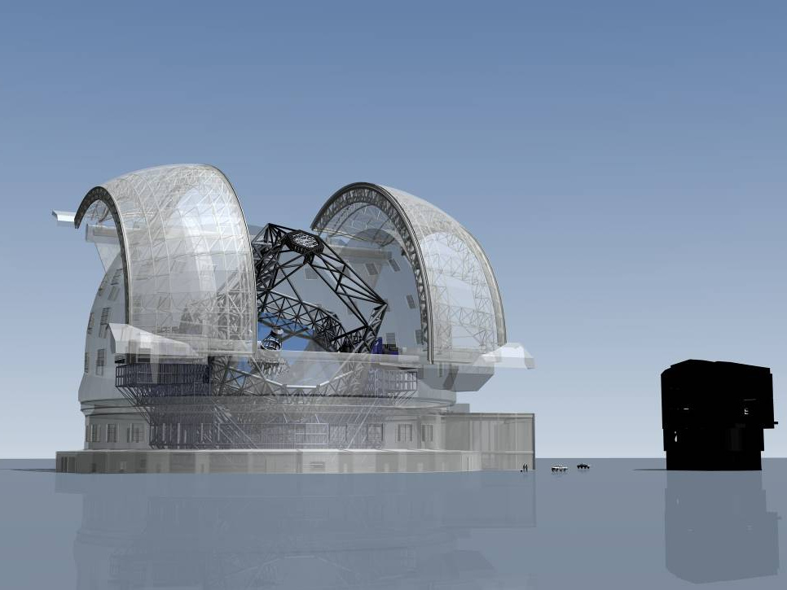


The World's Largest Eye on the Sky!
A 39m diameter, adaptive telescope
0.3-14 µm, 10’ diff limited FoV
Approved Dec 2012
Funded for phase 1 Dec 2014
First light 2024 (est)
Total Cost: € 1082 million (2012)
E-ELT
VLT
Top priority for European ground-based astronomy
Notes:
E-ELT shown with the VLT – see mammoth difference (at least in dome)
In collecting area factor of 22 times large than the VLT
This is the title slide for the E-ELT part of the talk

Slide 3
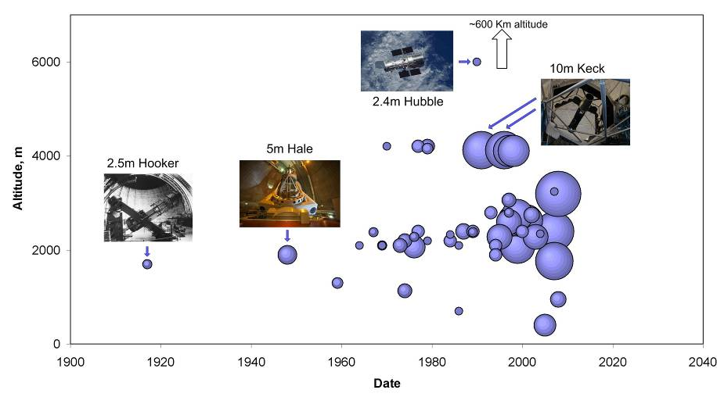
Telescope Mirror Size Progression
2m and more
Notes:
This+18 shows the ELT mirror size in comparison to existing 2m+ telescopes
typically a step of 2 from one generation to the next.

Slide 4
Telescope Mirror Size Progression
2m and more
E-ELT 39m
Larger collecting area than all major observatories put together!
Notes:
Shows the E-ELT mirror mention that it’s collecting are is larger than all existing major observatory mirrors put together
More than a step of 2
Last step 8m-10m 15 years ago, time to make the next step

Slide 5
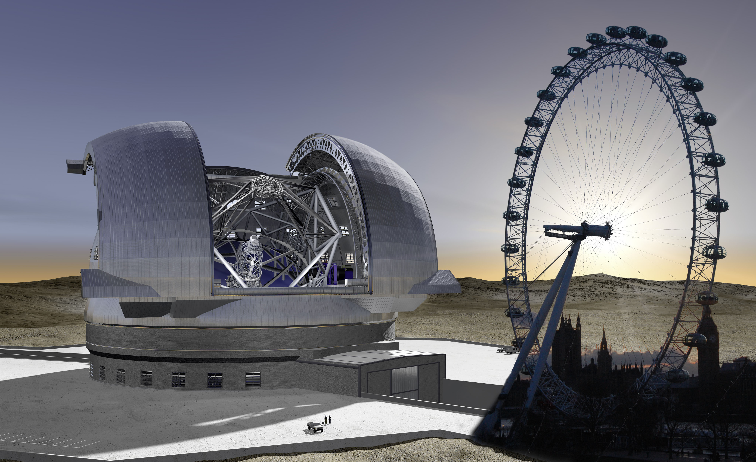
Notes:
Another Size reference
UK-related title page with London Eye uses pre2011 E-ELT rendered figs

Slide 6
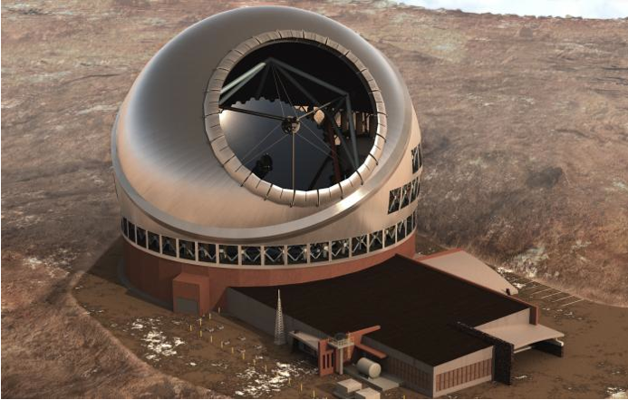
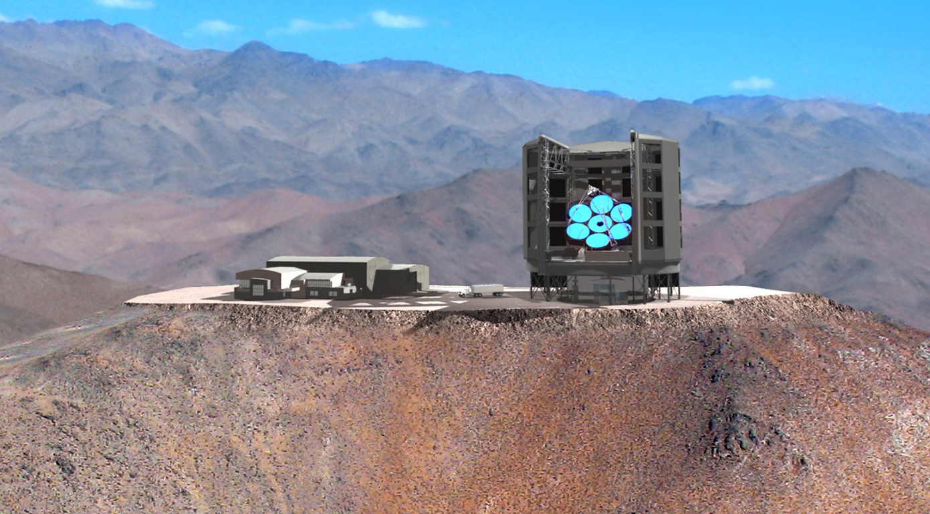
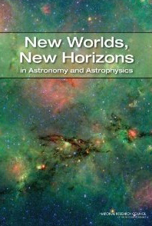
Other International ELTs
Thirty Meter Telescope
30m diameter (492x1.4m)
Unvignetted FoV 15’, 0.3-28um
U. California (10), Caltech, Canada Japan, China, India ($100M)
Construction proposal complete
NSF partnership sought
www.tmt.org
Giant Magellan Telescope
24m diameter (7x 8m)
Smallest ELT largest FoV (20’), , 0.3-25um
Collaboration of private US universities, Australia (ANU + AAL) + Korea
First 2 mirrors polished, 3rd mirror cast
Site blasted (Mar 2012) & levelling
www.gmto.org
Giant Segmented Mirror Telescopes (GSMT) top priority: NSF investment
Notes:
In December, the NSF issued a call for proposals to develop a plan for partnering with the NSF, but is unable to commit to a partnership or to identify a path towards federal funding for construction before the end of the decade. The NSF solicitation offers $250,000 per year for 5 years in funding for activities related to community involvement, scientific workshops, and other planning work. Cannot commit funds for construction until the next decade.

Slide 7
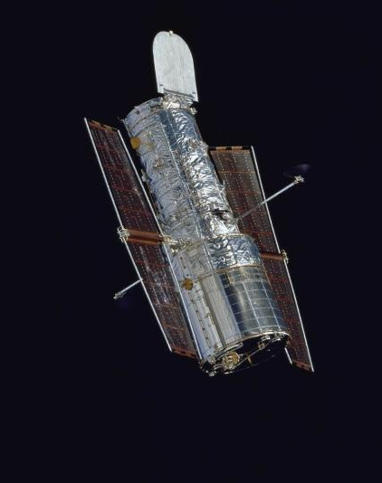

ELT primary mirrors
JWST
6.5m (2018)
HST
2.4m
GMT
24m
(2020, 4seg
2023, 7seg)
E-ELT
39m
(2024)
TMT
30m
(2022)
VLT
8m
Collecting area = sensitivity
Diameter = resolution (with AO)
Notes:
Comparison of ELT mirror size & reminder why we want to go bigger

Slide 8
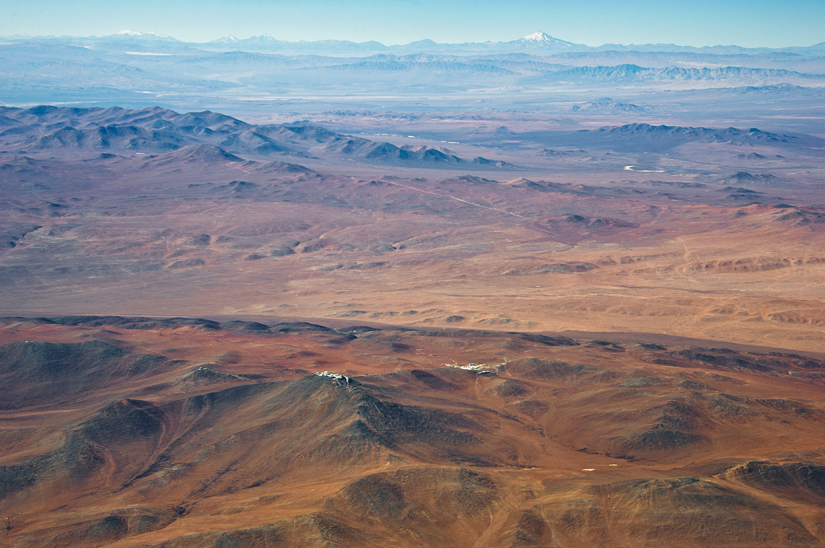
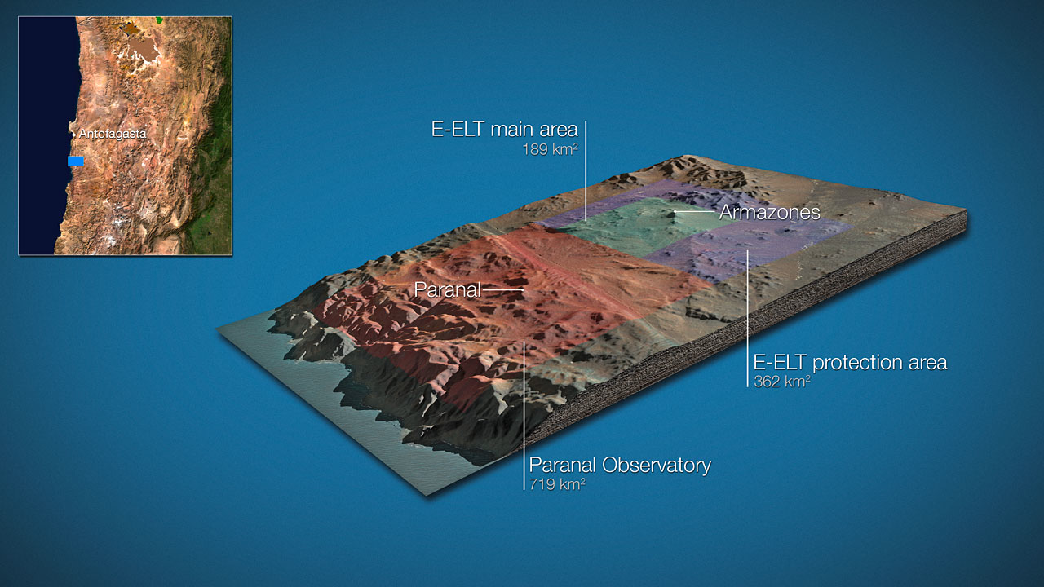
Vn. Llullaillaco
Armazones
Oct 2011: ESO & Chilean agreement including donation of 189 km² of land & further 362 km² 50yr protected area in return 10% observing time
Paranal
Notes:
Llullaillaco (pronounced You-ya-i-yaco, meaning “dirty lagoon” in Ketschua), at 6739 metres above sea level, the third-highest peak in Chile,
he seventh highest in the Andes, and argu- ably the highest active volcano in the world. T The last eruption of Llullaillaco was recorded in 1877. It has beautiful lava flows extending both to the north and south. During most of the year it appears as snow-capped,
the Paranal– Llullaillaco line of sight (LOS) spans 190 kilometres, starting on the Paranal platform at an elevation of 2600 metres and ending at 6739 metres, right at the
Chilean–Argentine border. This is almost the entire width of Chile at this latitude.

Slide 9
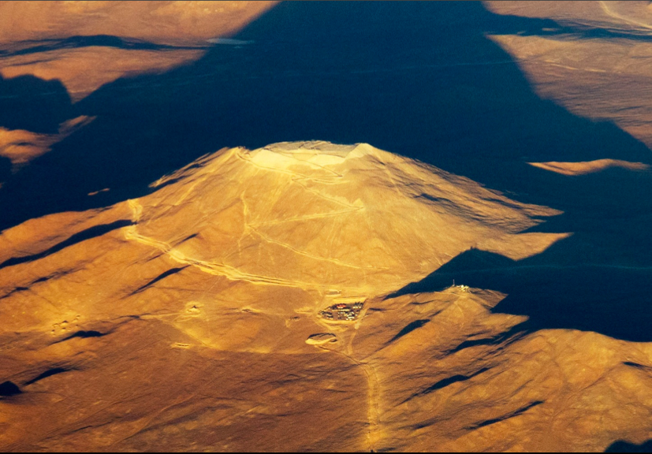
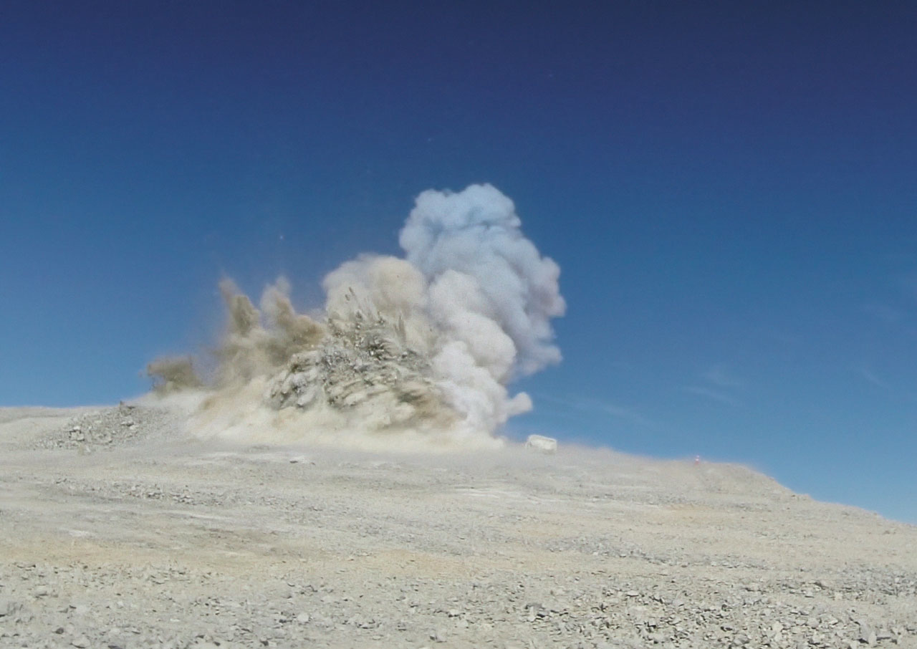
Site
Notes:
19th June 2014

Slide 10
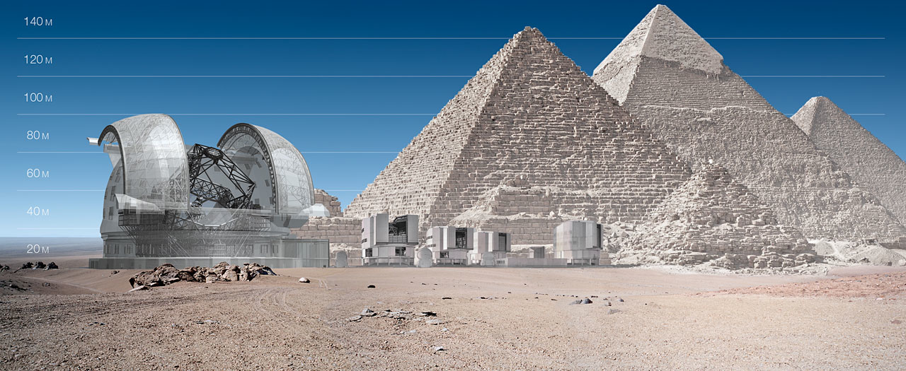
E-ELT First Generation Instruments

Slide 11
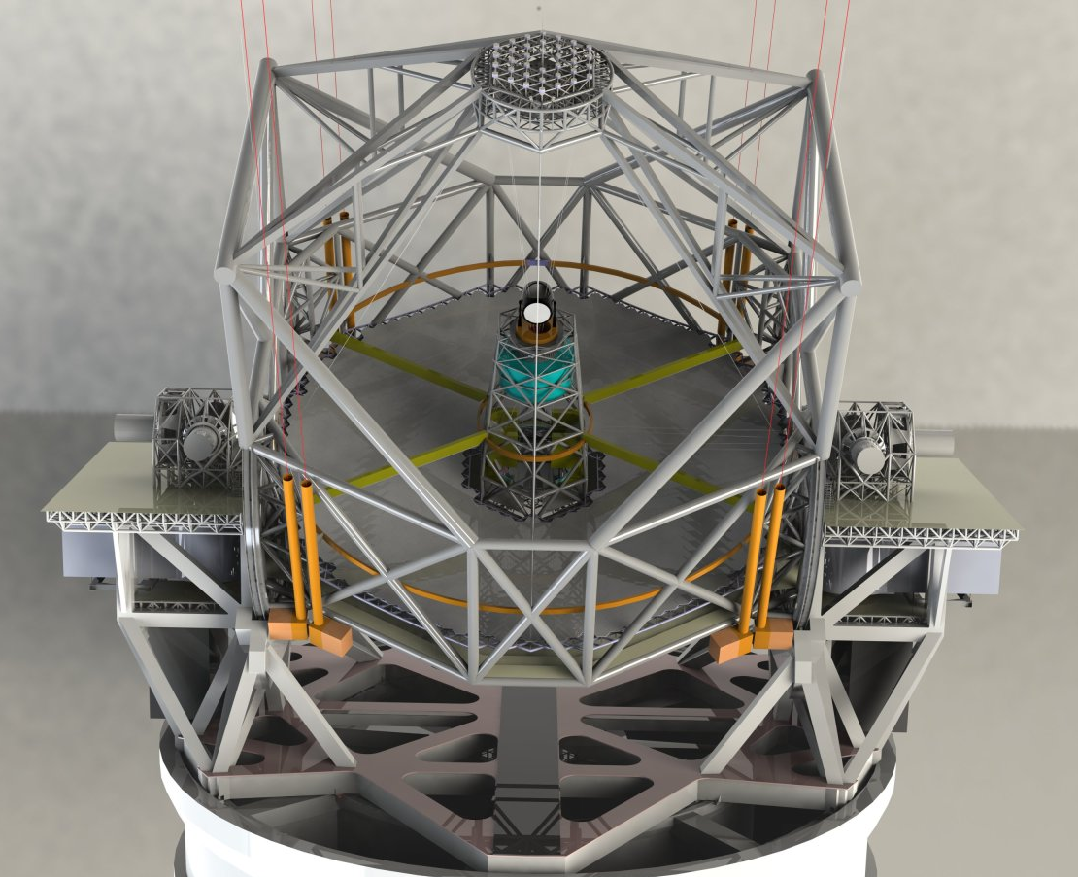
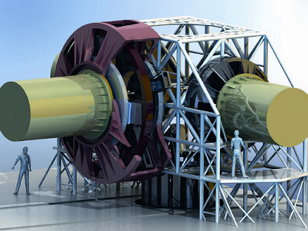
E-ELT instrumentation
8 instruments and 2 adaptive optics modules are foreseen for the E-ELT
Collaborations with institutes in ESO community
Two selected for first light
One of which HARMONI lead by Oxford
Full instrument suite to be built up over first decade

Slide 12
Phase A Instrument Studies
CODEX Ultra-high-resolution optical spectrograph
Luca Pasquini (ESO) (UK: Martin Haehnelt, Cambridge)
EAGLE Multi-IFU, AO-fed near-IR spectrometer
Jean-Gabriel Cuby (LAM), Simon Morris (Univ Durham)
EPICS XAO imager/spectro-polarimeter for exo-planets
Markus Kasper (ESO) (UK: Matthias Tecza, Oxford)
HARMONI Diffraction-limited, visible-NIR IFU
Niranjan Thatte (Univ Oxford)
METIS Mid-IR (3-14µm) imager & spectrometer
Bernhard Brandl (NOVA, Leiden) (UK: Alistair Glass, ATC)
MICADO Near-IR, high-resolution imaging camera
Reinhard Genzel (Max Planck Institute for Extraterrestrial Physics)
OPTIMOS Seeing-limited/GLAO high-multiplex spectrograph
Olivier Le Fevre (LAM), Francois Hammer (GEPI), Gavin Dalton (Univ Oxford)
SIMPLE Near-IR, high-resolution spectrograph
Livia Origlia (INAF, Bologna) (UK: Roberto Maiolino, Cambridge)
AO-relays MAORY (MCAO relay) & ATLAS (LTAO relay)
✪ ELT-PCS
✪ ELT-IFU
✪ ELT-MIR
✪ ELT-CAM
Notes:
ELT-IFU & ELT-CAM are 1 st light (red)
ELT-MIR & ELT-PCS are selected (I.e. will be built) but awaiting technological readiness reviews (orange)
Colour coding of instrument descriptions
Orange in names means those with large UK involvement,
yellow with some UK involvement ~10% level,
beige means some UK involvement mostly on science team
White means no UK involvement

Slide 13
Phase A Instrument Studies
CODEX Ultra-high-resolution optical spectrograph
Luca Pasquini (ESO) (UK: Martin Haehnelt, Cambridge)
EAGLE Multi-IFU, AO-fed near-IR spectrometer
Jean-Gabriel Cuby (LAM), Simon Morris (Univ Durham)
EPICS XAO imager/spectro-polarimeter for exo-planets
Markus Kasper (ESO) (UK: Matthias Tecza, Oxford)
HARMONI Diffraction-limited, visible-NIR IFU
Niranjan Thatte (Univ Oxford)
METIS Mid-IR (3-14µm) imager & spectrometer
Bernhard Brandl (NOVA, Leiden) (UK: Alistair Glass, ATC)
MICADO Near-IR, high-resolution imaging camera
Reinhard Genzel (Max Planck Institute for Extraterrestrial Physics)
OPTIMOS Seeing-limited/GLAO high-multiplex spectrograph
Olivier Le Fevre (LAM), Francois Hammer (GEPI), Gavin Dalton (Univ Oxford)
SIMPLE Near-IR, high-resolution spectrograph
Livia Origlia (INAF, Bologna) (UK: Roberto Maiolino, Cambridge)
AO-relays MAORY (MCAO relay) & ATLAS (LTAO relay)
HIRES
✪ MOSAIC
Notes:
ELT-IFU & ELT-CAM are 1 st light (red)
ELT-MIR & ELT-PCS are selected (I.e. will be built) but awaiting technological readiness reviews (orange)
Colour coding of instrument descriptions
Orange in names means those with large UK involvement,
yellow with some UK involvement ~10% level,
beige means some UK involvement mostly on science team
White means no UK involvement

Slide 14
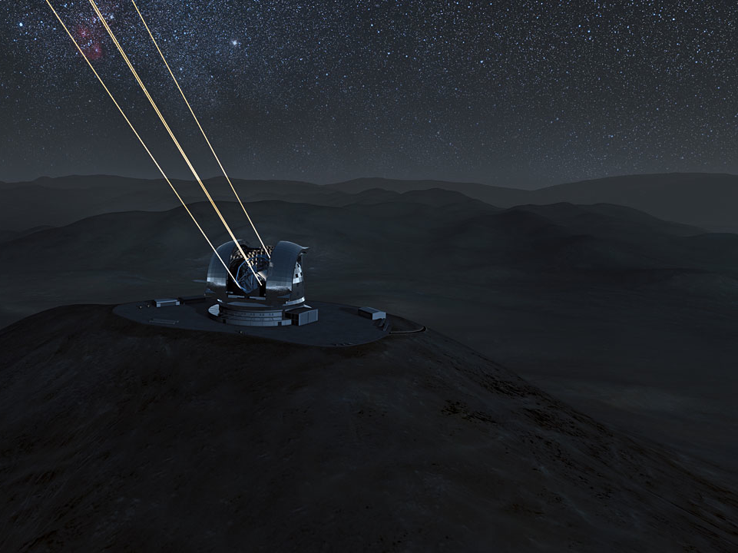
Anticipated Schedule
Start 2013
Technical First Light 2023
First Instrument 2024
Operations 2024

Slide 15
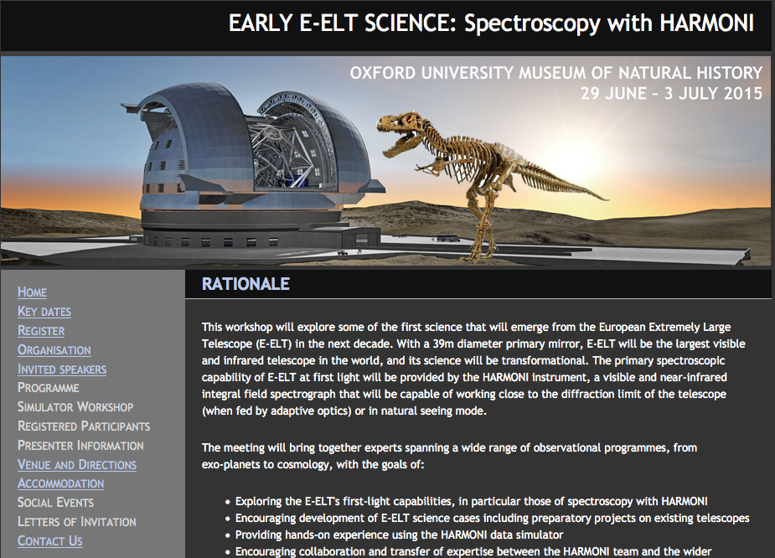
*T-Rex not to scale! It’s in the foreground!!!
harmoni2015.physics.ox.ac.uk

Slide 16
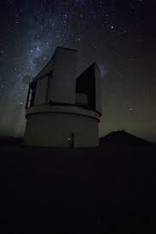
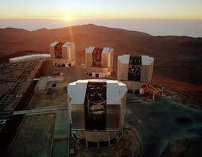
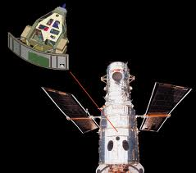
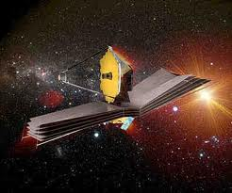
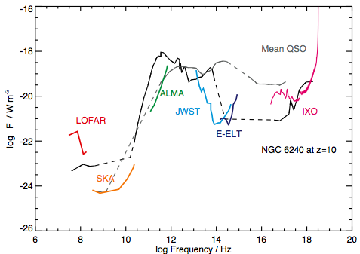

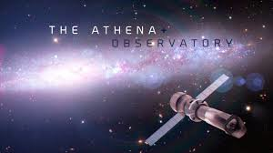
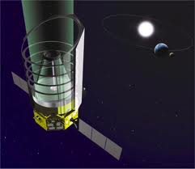
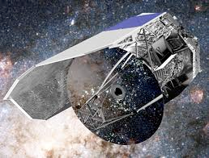
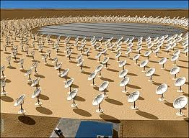
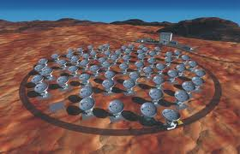
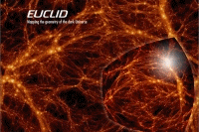

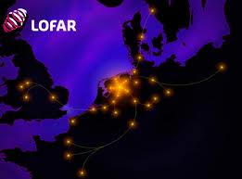
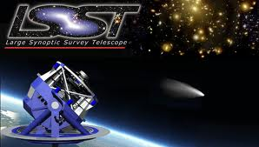

Synergies with major facilities
Synergies across most areas of astronomy
sensitivity
matching high angular resolutions:
  different wavelengths and spectral resolutions (e.g. ALMA)
matching wavelengths:
  different angular and/or spectral resolutions (e.g. JWST)
  8mas in H (JWST 64mas) 18mas in L (JWST 130mas)
Spectroscopic and high angular resolution follow-up of sources discovered with current & future 4m-10m telescopes
  Opt/NIR telescopes (VLT, Keck, VISTA, PANSTARRS, LSST), HST, Herschel, LOFAR, GAIA, JWST, EUCLID…
IXO Science Case, K. Nandra
Notes:
Future facilities with synergies to the E-ELT prob not complete – perhaps a bit obscure for the public
The plot shows an AGN dominated source (NGC6240) redshifted out to z=10 to show the complementarity between some future facilities (made for the IXO science case)

