Slide 1
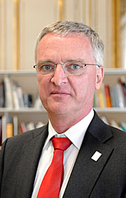
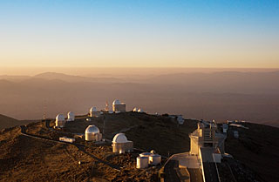
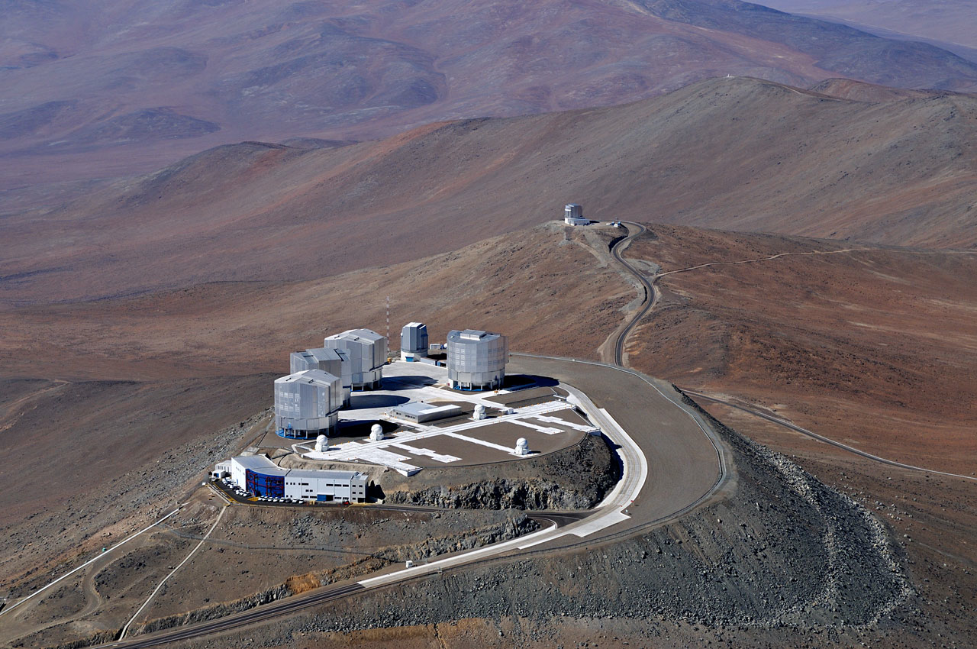
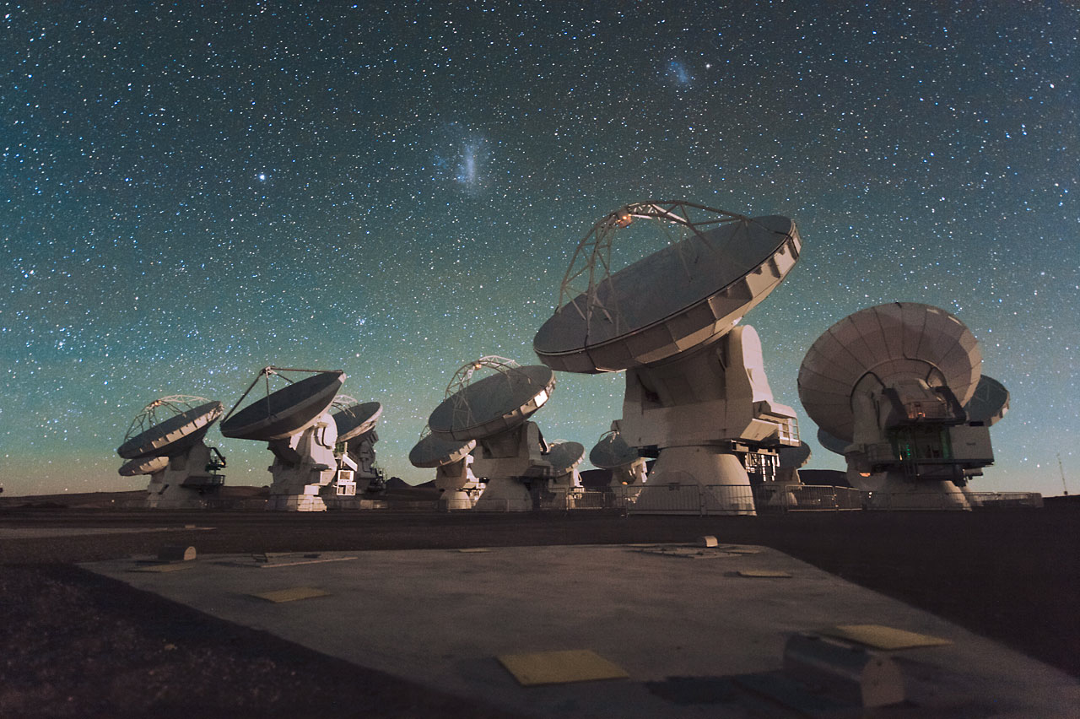
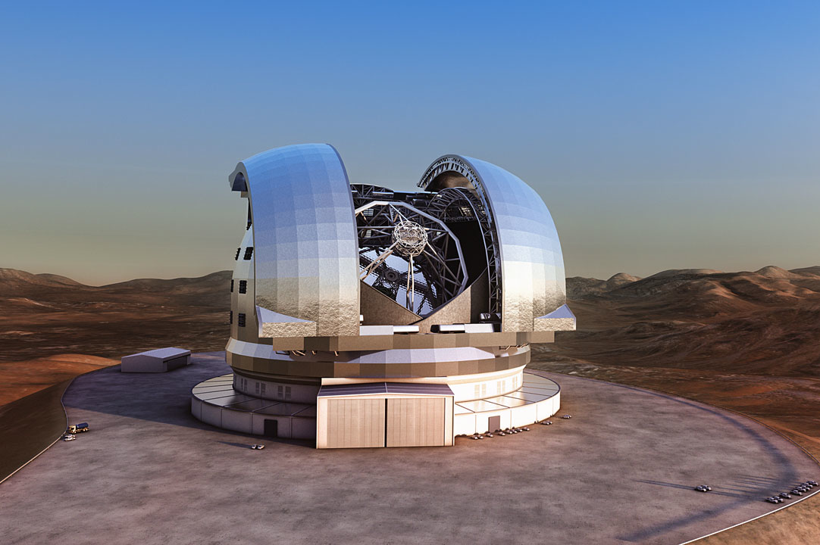
Recent Developments at the European Southern Observatory Professor Tim de Zeeuw ESO Director General
Special Seminar
Thursday 18th September 2014 11:30
Martin Wood Lecture Theatre
ESO is an intergovernmental organisation for astronomy founded in 1962 by five countries. It currently has 14 Member States in Europe with Brazil poised to join as soon as the Accession Agreement has been ratified. Together these countries represent approximately 30 percent of the world’s astronomers. ESO operates optical/infrared observatories on La Silla and Paranal in Chile, partners in the sub-millimetre radio observatories APEX and ALMA on Chajnantor and has started construction of the Extremely Large Telescope on Armazones near Paranal.
La Silla hosts experiments, robotic and national telescopes as well as the NTT and the venerable 3.6m telescope. The former had a key role in the discovery of the accelerating expansion of the Universe and the latter hosts the ultra-stable spectrograph HARPS which is responsible for the discovery of nearly two-thirds of all confirmed exoplanets with masses below that of Neptune. On Paranal the four 8.2m units of the Very Large Telescope, the Interferometer and the survey telescopes VISTA and VST together constitute an integrated system which supports 16 powerful facility instruments, including adaptive-optics-assisted imagers and integral-field spectrographs, with half a dozen more on the way and the Extremely Large Telescope with its suite of instruments to be added in about ten years time. Scientific highlights include the characterisation of the supermassive black hole in the Galactic Centre, the first image of an exoplanet, studies of gamma-ray bursts enabled by the Rapid Response Mode and milliarcsec imaging of evolved stars and active galactic nuclei. The single dish APEX antenna, equipped with spectrometers and wide-field cameras, contributes strongly to the study of high-redshift galaxies and of star- and planet-formation. Early results obtained with ALMA already demonstrate its tremendous potential for observations of the cold Universe.
The talk will summarize the current programme, with emphasis on recent increases in capabilities, and briefly consider opportunities for the future.
Image credits: ESO

